Slide 1
Use Data Science to Boost Job Searching
Jonathan Liu

Slide 2
Job Searching is A Full Time Job
Learn about job market
Industries
Employers
Skills
Resume polishing
Relevant Keywords

Slide 3
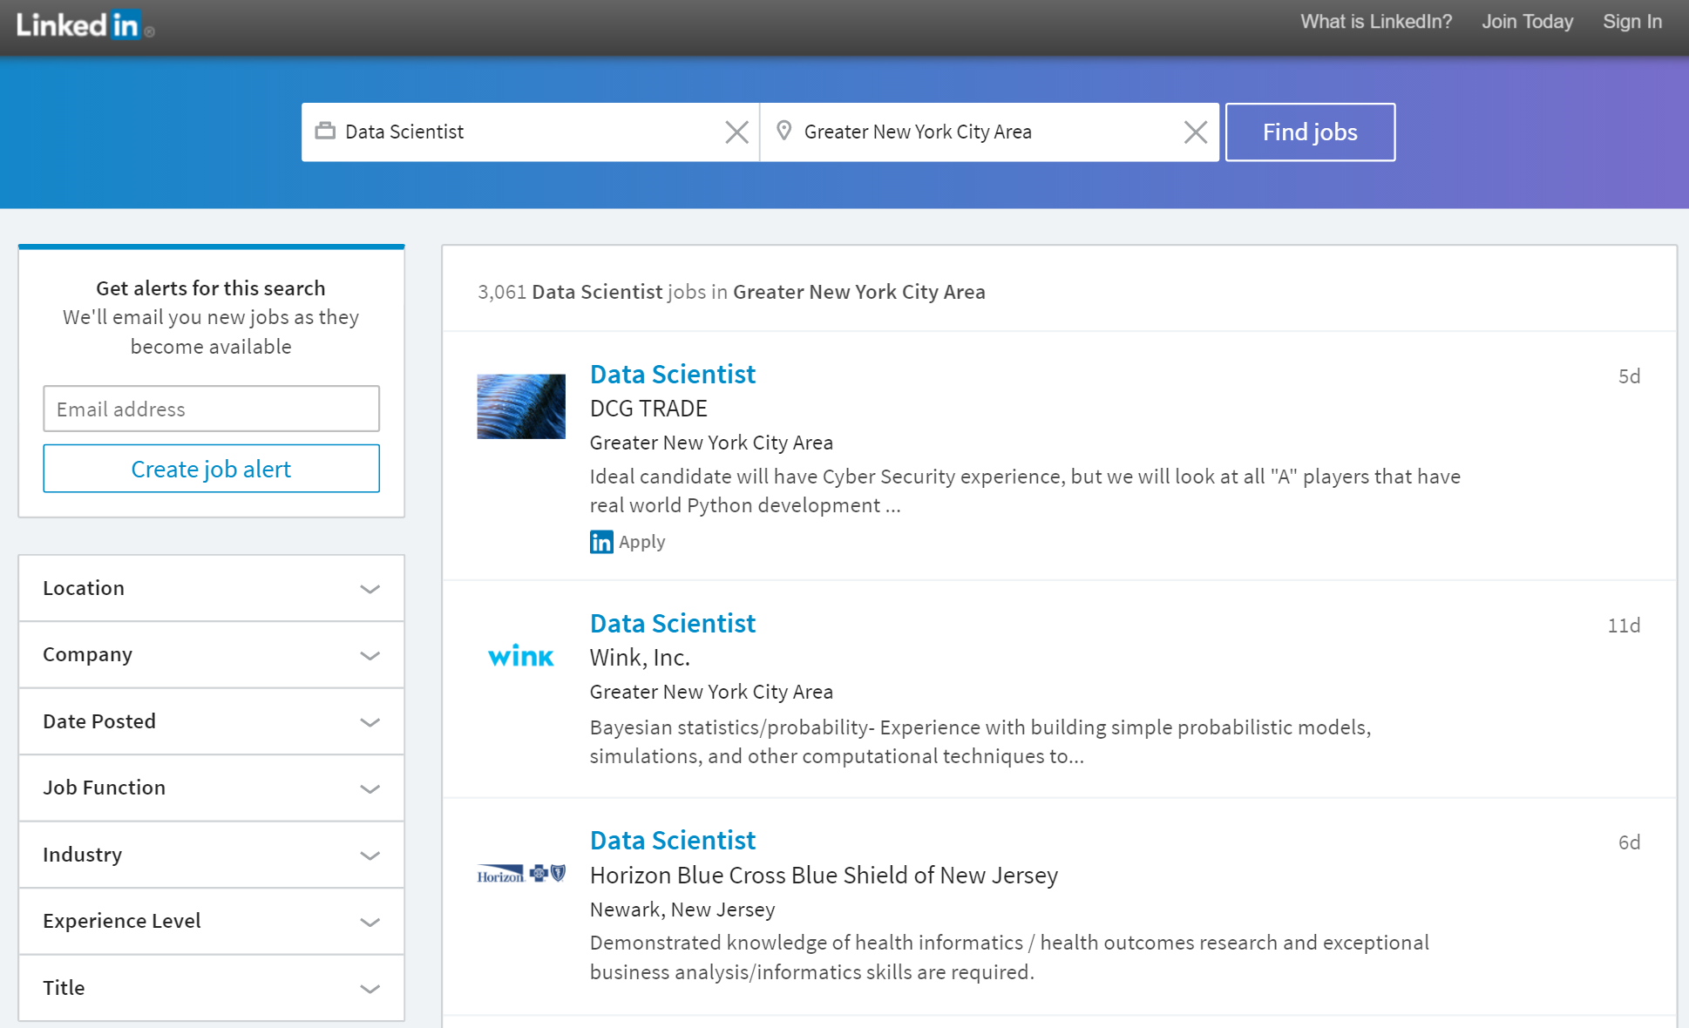
Keyword
Location
Filters

Slide 4






Job Description
LinkedIn Job Listing
Feature Extraction
Job Detail

Slide 5
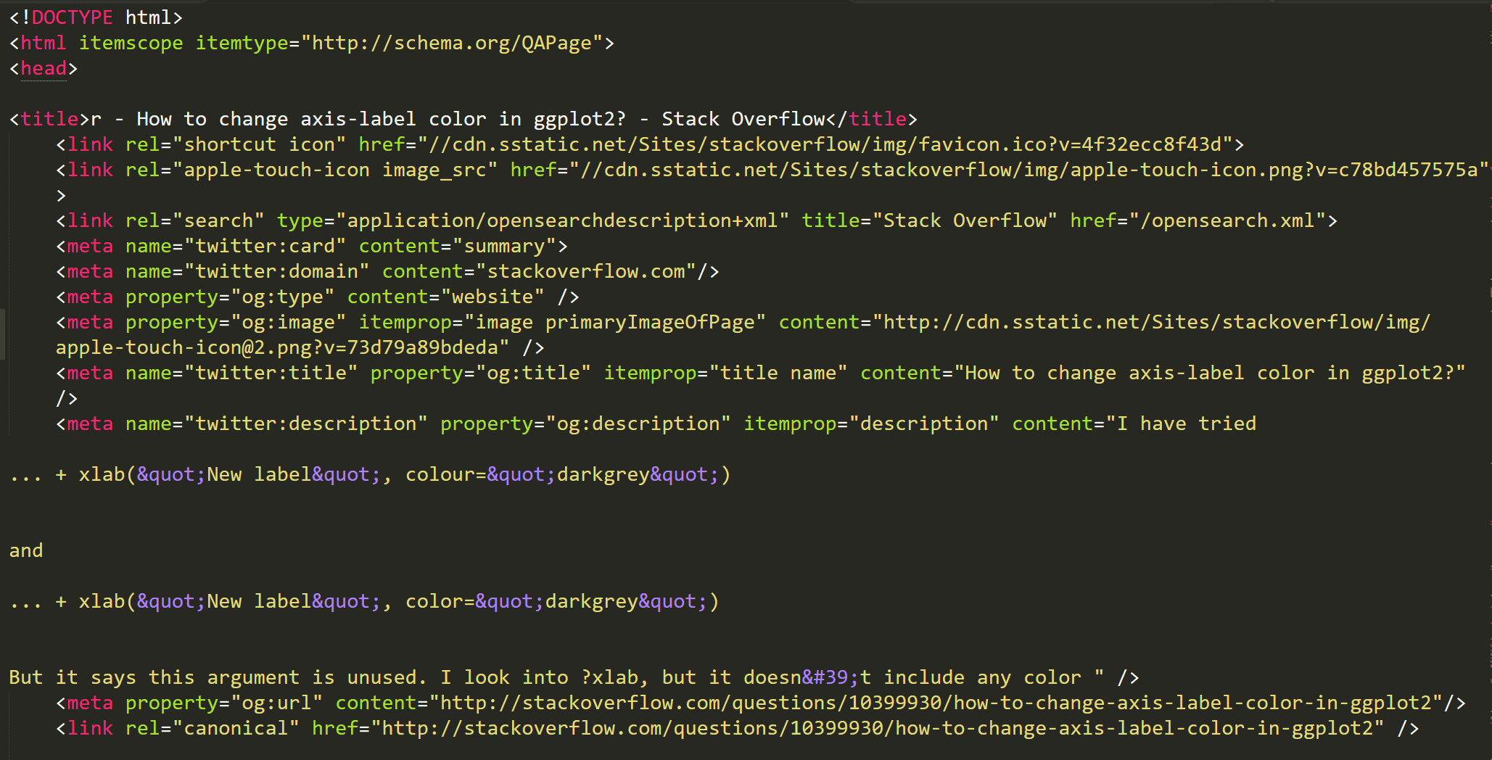

Slide 6
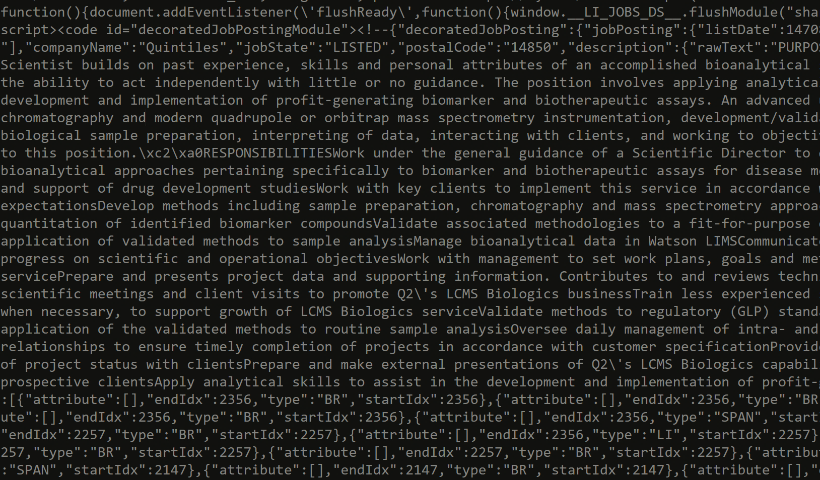

Slide 7

Job Function
Company Industry
Post Date
Description

Slide 8
Quick Insights

Slide 9
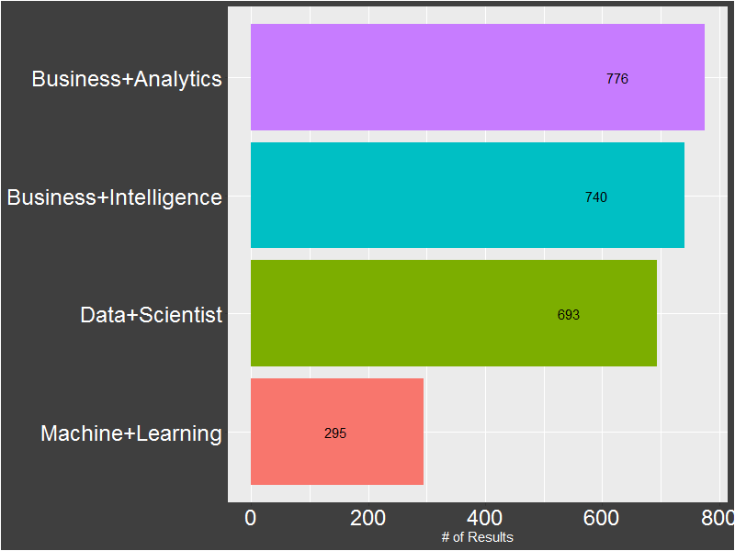
Search Results by Key Words

Slide 10
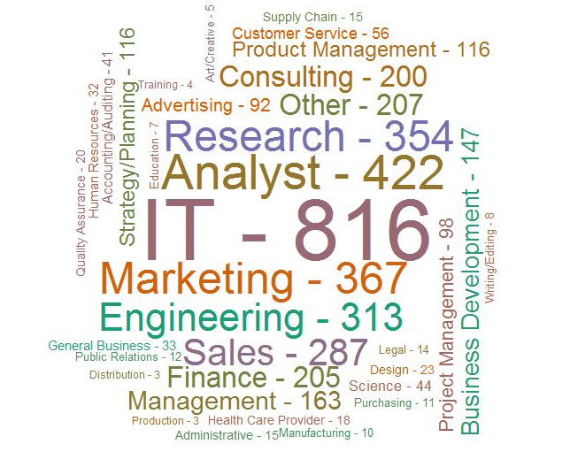
Job Functions

Slide 11
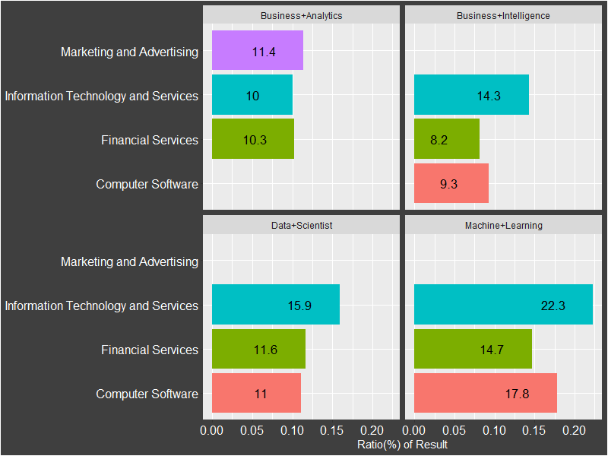
Top 3 Industries by Search Term

Slide 12
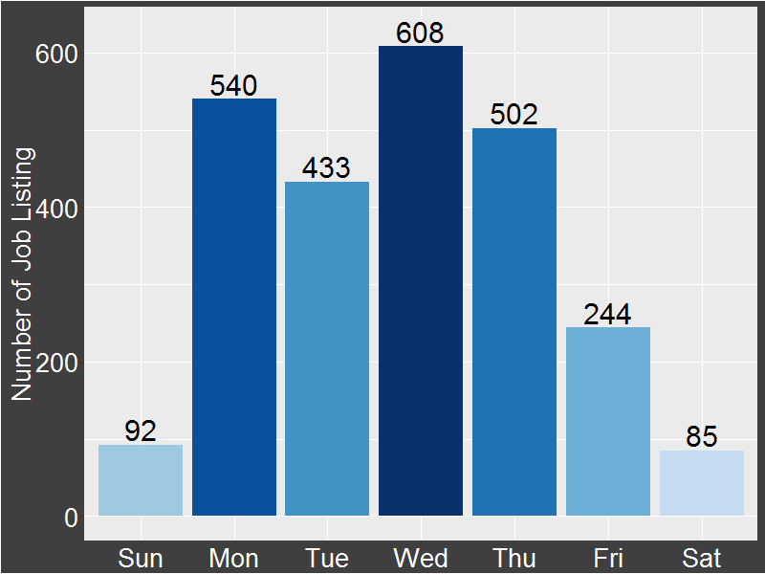
Number of Listings by Weekdays

Slide 13
What about skills?

Slide 14
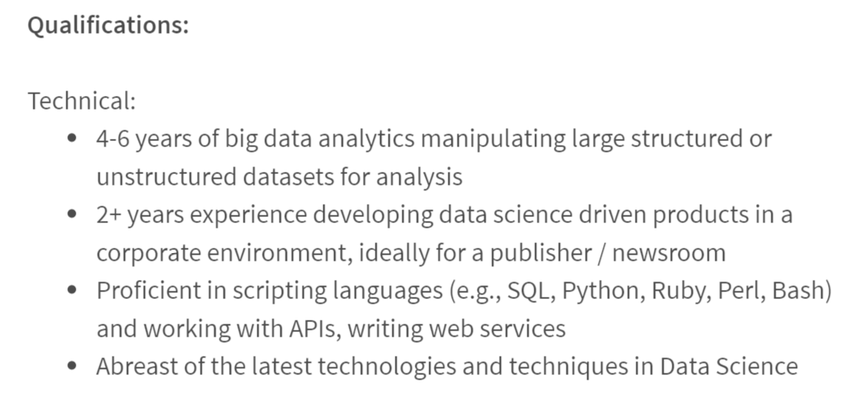
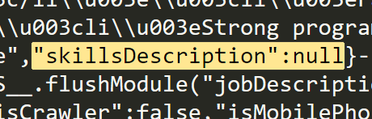

Slide 15
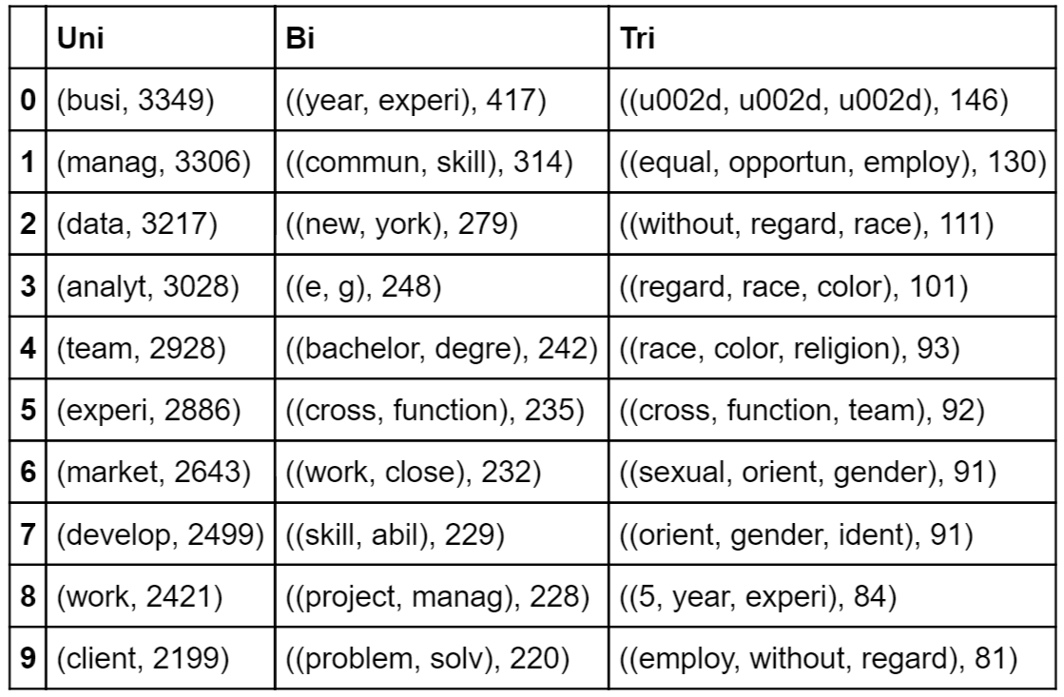
N-grams – Business Analytics

Slide 16
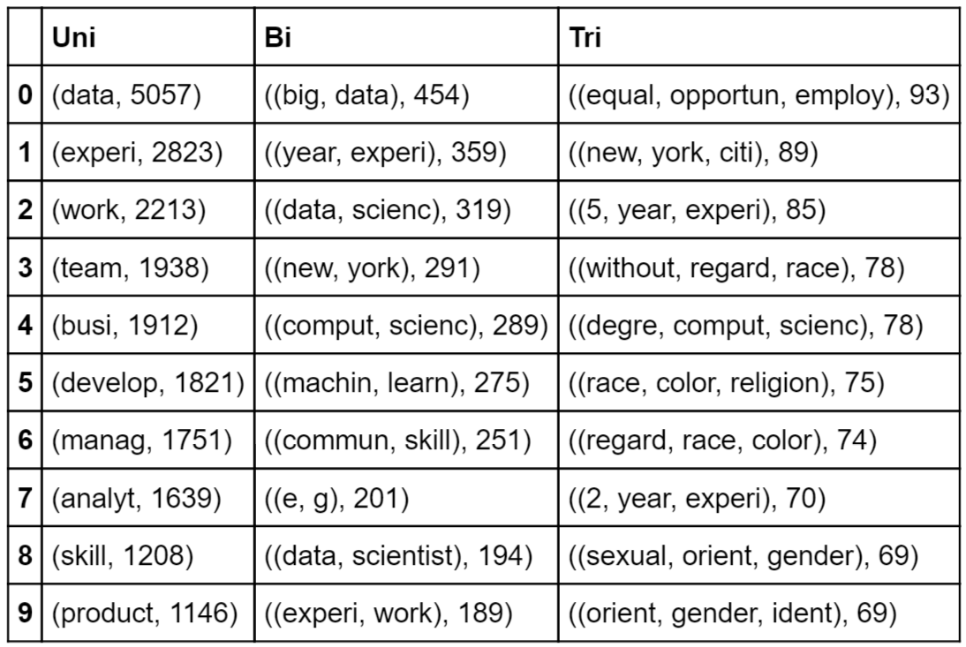
N-grams – Data Scientist

Slide 17
Given my skill set, what is the most relevant keyword (skill) mentioned in job descriptions?

Slide 18
Word2Vec
Scan through documents, n words each time, build shallow neural networks to learn relationship between words “in the window” and “outside of the window”

Slide 19
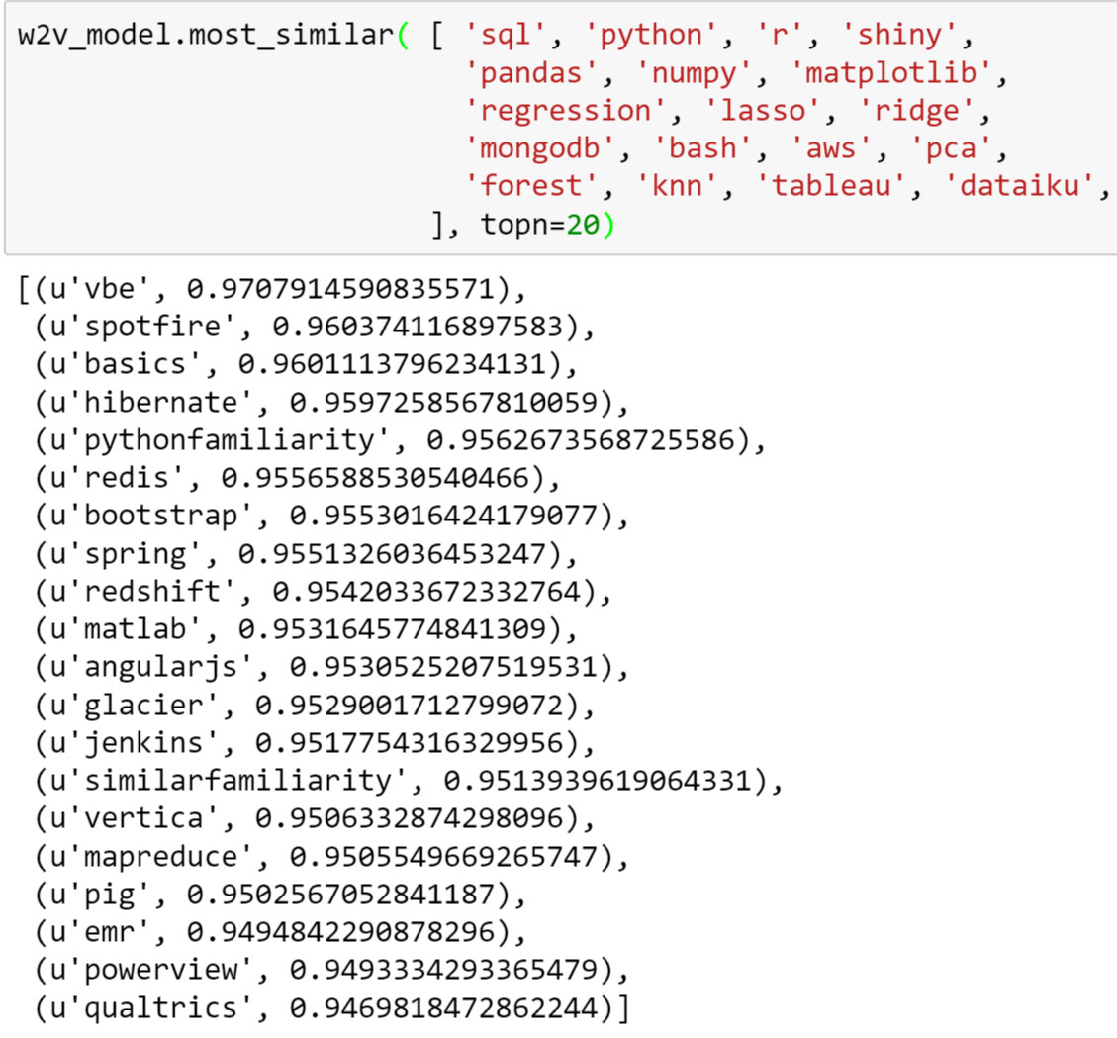

Slide 20
Q & A

